Slide 1
Node JS - DB
S.Karthiga,
Assistant Professor,
Department of IT,TCE

Slide 2
Session Outcomes
At the end of this session, students will be able to,
Apply mysql module for the given problem

Slide 3

Installation– code & output
https://www.mysql.com/downloads/.

Slide 4
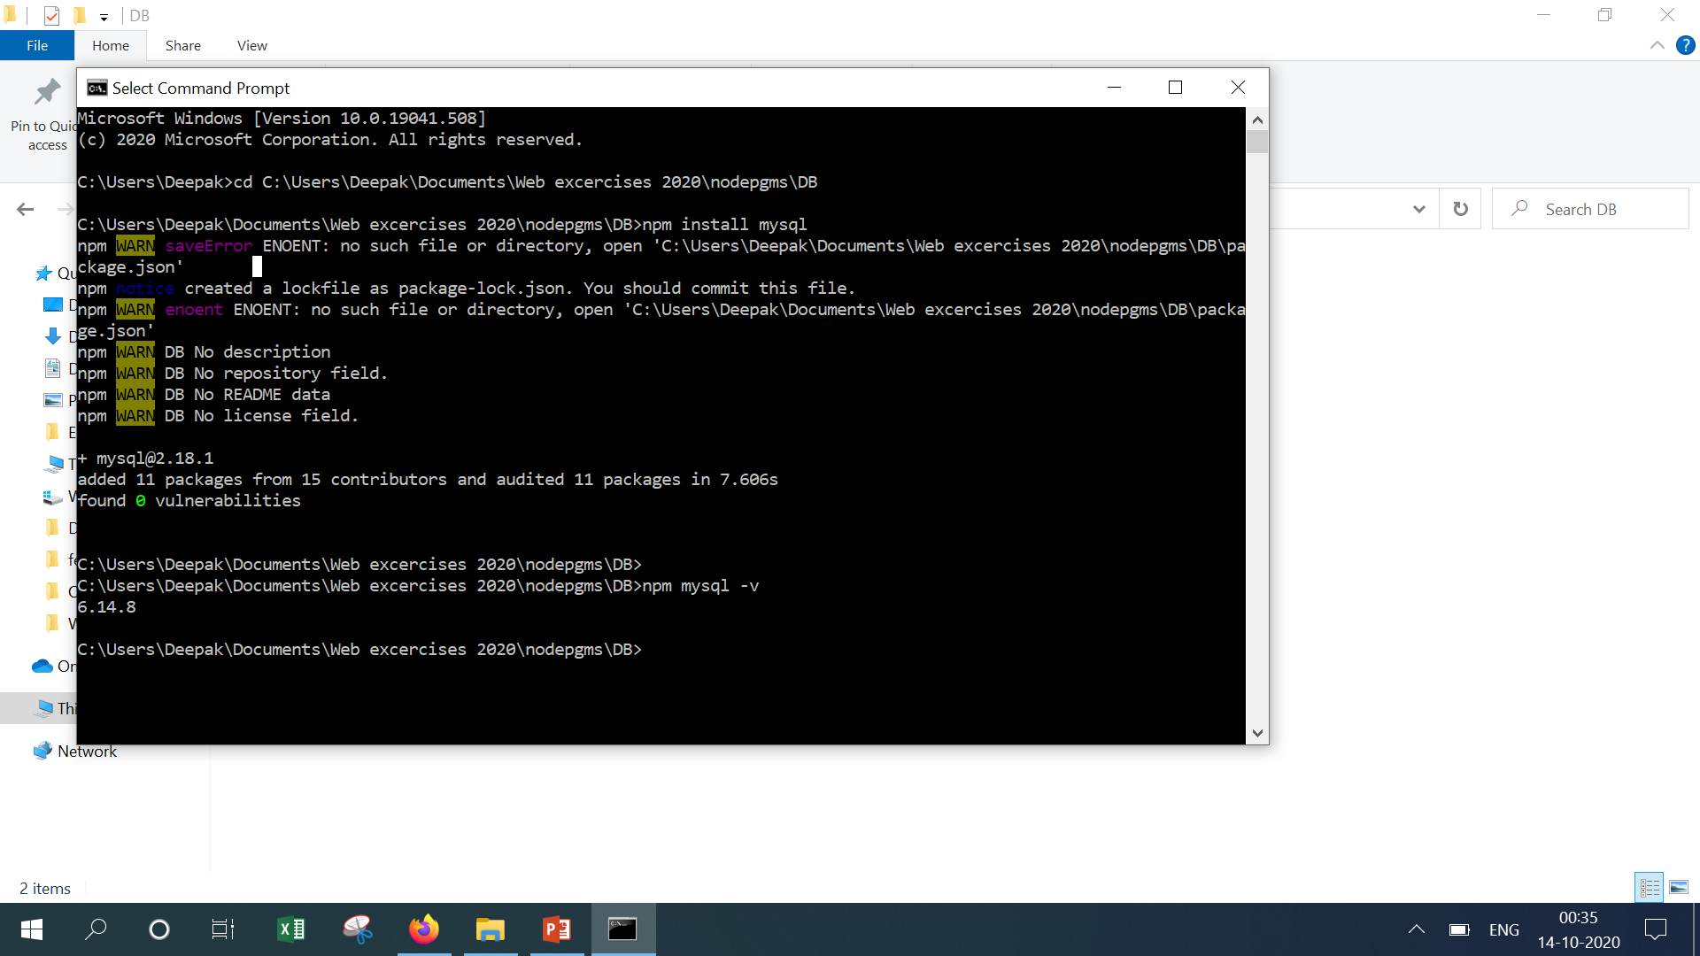

Slide 5
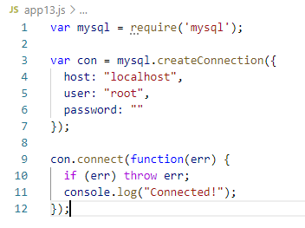

DB Connection – code & output

Slide 6
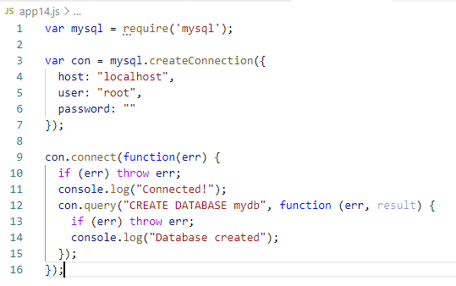

DB Creation – code & output

Slide 7
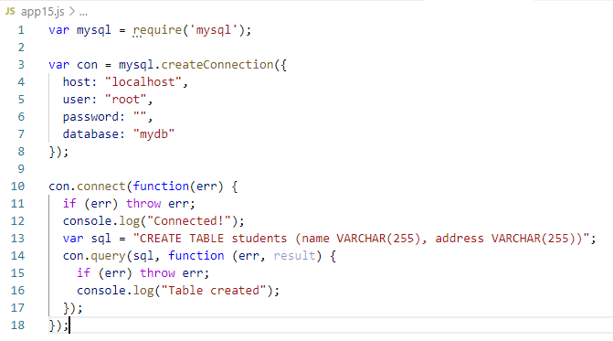

Table Creation – code & output

Slide 8
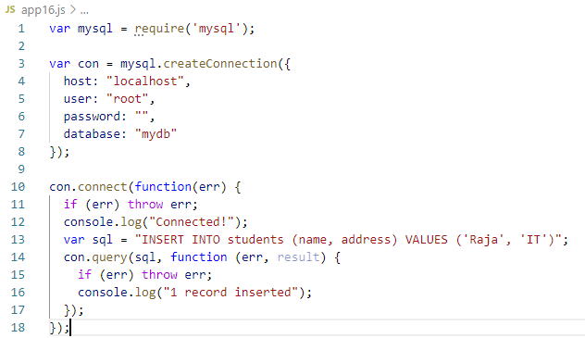

Insert Record – code & output

Slide 9
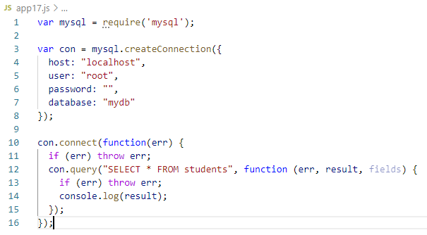
Select results– code & output

Slide 10
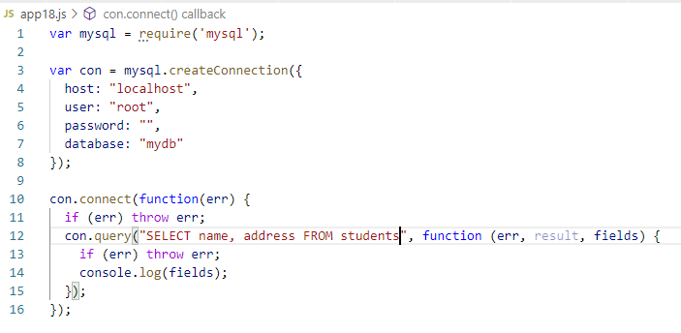
Field details – code & output

Slide 11
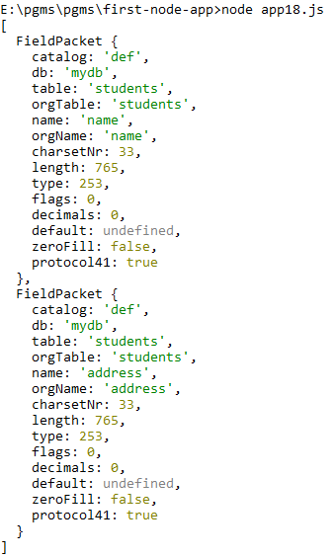
Output

Slide 12
Demo

